Slide 1
PSCS_452 - Freelancing Platform
CSE7101- Capstone Project
Review-1
Batch Number: COM_62
Under the Supervision of,
Dr. Ruhin Kouser R
Assistant Professor – Senior Scale
School of Computer Science and Engineering
Presidency University
Roll Number | Student Name
20221COM0002 | Prithvi Krishnan M
Name of the Program: B.Tech – Computer Engineering (Artificial Intelligence & Machine Learning)
Name of the HoD: Dr. Pallavi R
Name of the Program Project Coordinator: Ms. Benitha Christinal J
Name of the School Project Coordinators: Dr. Sampath A K , Dr. Geetha A

Slide 2
Content
Problem Statement
Objectives
Background and Related work for title Selection
Analysis of Problem Statement
Innovation or Novel Contributions
GitHub Link
Project Timeline
References

Slide 3
Problem Statement
Organization: Freelancing & Gig Economy Platform for Indian Market
Category: Software
Problem Description: Freelancers and clients in India face persistent challenges in current online marketplaces:
  Trust Deficit.
  Payment Risks.
  High Commission Rates.
  Limited Local Payment Options.
  Manual & Inefficient Talent Search.
  Lack of AI Assistance.
  These challenges hinder growth and trust in the Indian freelancing ecosystem, creating a need for a secure, localized, and AI-driven solution.

Slide 4
Objectives
Create a secure AI-powered freelancing marketplace for the Indian market
Connect freelancers and employers for gigs, projects, and short-term jobs
Offer profile & portfolio management with ratings/reviews
Enable AI-driven job & talent matching
Integrate escrow-based payments and UPI/bank transfers
Provide built-in project management & communication tools

Slide 5
Background and Related work
Background
  Freelancing in India is growing rapidly with remote work trends.
  Current platforms lack regional focus, local payment options, and language support.
  Increasing demand for flexible, skill-based work opportunities.
  Businesses seek cost-effective and on-demand talent.
  Many freelancers face challenges in getting visibility and trust.
Related Work
  UpWork - Global reach, minimal localization.
  Fiverr – Quick gigs, lacks full project management.
  Freelancer.com – Bidding model, high fees, limited Indian payment methods.

Slide 6
Analysis of Problem Statement
Hardware Requirements:
  Mid-range system: Intel i5 / Ryzen 5 or higher
  8–16 GB RAM, SSD storage
  Integrated/dedicated GPU, Full HD display
  Standard peripherals and stable internet
Software Requirements:
  OS: Windows / Linux / macOS
  Development: Python / Java, VS Code, GitHub
  Database: MySQL / PostgreSQL / MongoDB
  Frameworks: React, Node.js, TensorFlow / PyTorch
  Tools: Office suite, browser, version control

Slide 7
Analysis of Problem Statement
Technology Stack Components:
Layer | Technology | Purpose
Frontend | HTML, CSS, JavaScript, React | UI for users
Backend | Node.js + Express.js | Server-side logic, API handling
Database | MongoDB (Atlas) + Mongoose | Store users, jobs, proposals, reviews
Authentication | JWT | Secure login & route protection
File Storage | Multer (Node.js library) | File uploads for portfolios and work
Deployment | Render (free tier) | Host backend
Version Control | GitHub | Code management
AI Engine | OpenAI – GPT5 | AI-driven Assistance

Slide 8
Innovation or Novel Contribution
Simulated Payment Gateway – Mock secure transactions without real money.
Portfolio & File Sharing – Upload work samples and deliverables.
Role-Based Dashboards – Separate views for freelancers and clients.
End-to-End Lifecycle – From job posting to delivery in one platform.
Cloud & Free Stack – Deployed on free-tier cloud services with open-source tools.

Slide 9
Github Link
Link to the project repository is provided here for version tracking and future development.
GitHub Link: Prithvi-2k4/ai-freelance-escrow-india: AI-powered freelancing platform tailored for the Indian market with integrated escrow payments to ensure secure transactions between clients and freelancers.

Slide 10
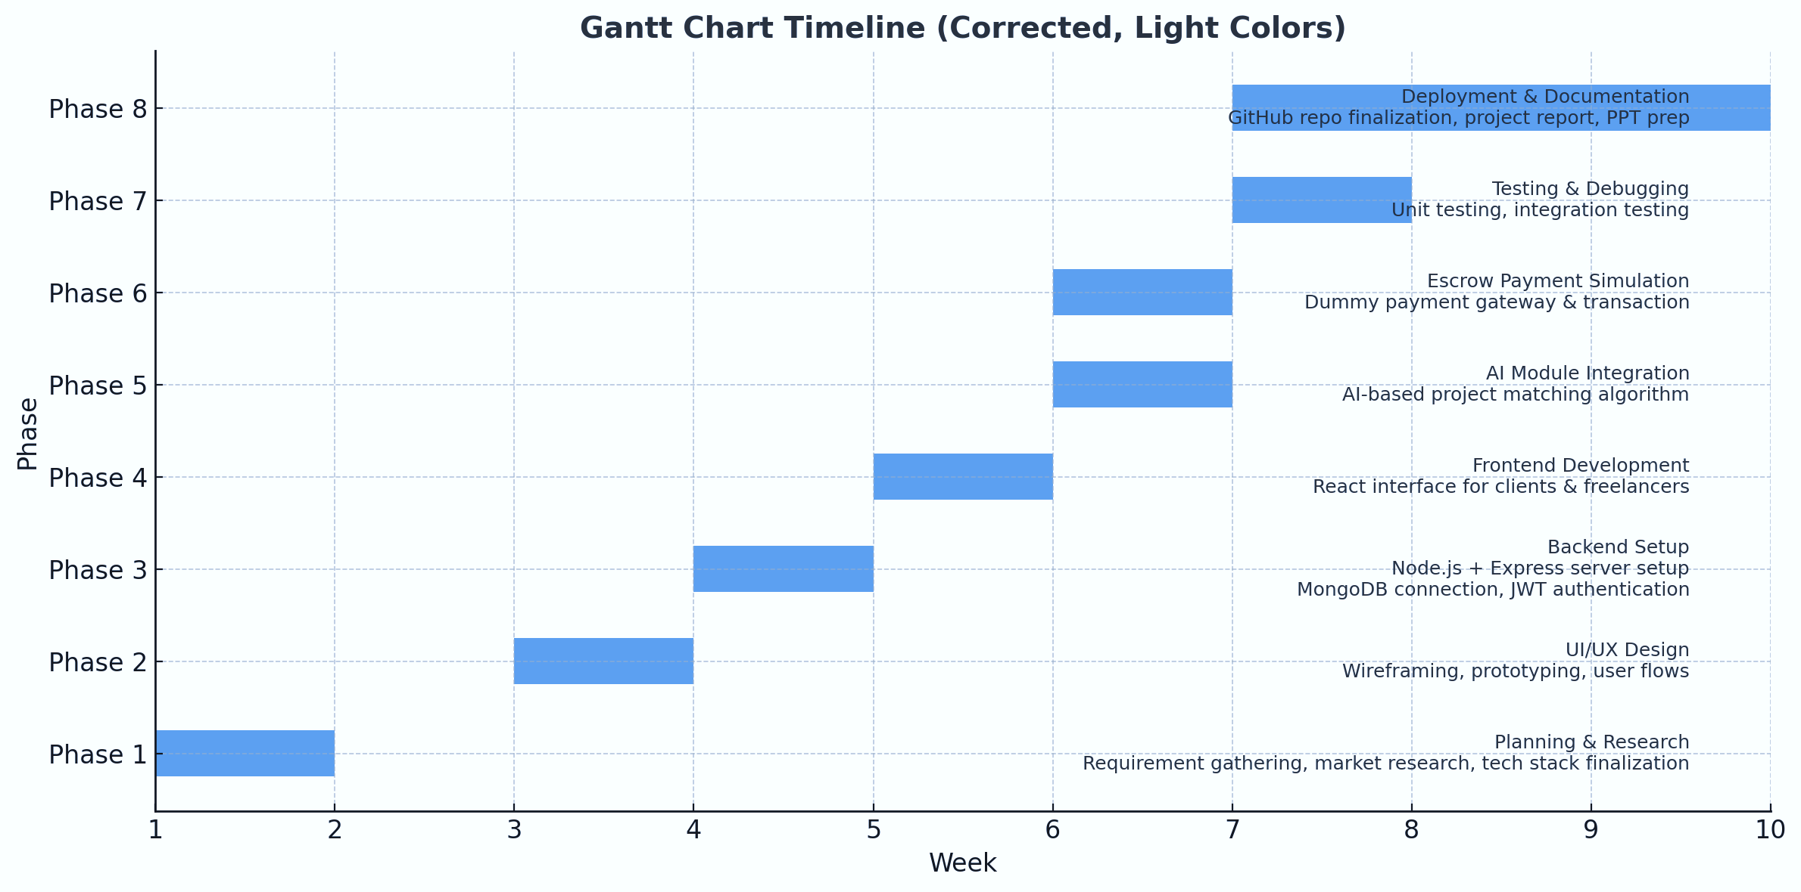
Project Timeline

Slide 11
References
[1] M. S. Arefin and M. S. Hossain, “Development of an intelligent job recommender system for freelancers using client’s feedback classification and association rule mining techniques,” in Proc. [Conference/Journal Name], Jun. 2019.
[2] A. Rezaei and Y. Lin, “A semantic job recommendation system based on deep learning,” IEEE Trans. Emerg. Topics Comput., vol. 8, no. 2, pp. 263–274, Apr.–Jun. 2020.
[3] AI-Powered Freelancing: A Design Framework for Smarter Job Allocation, OAIJSE, vol. 8, no. 3, 2025.
[4] H. Zhang, Z. Lin, and X. Hu, “The effectiveness of the escrow model: An experimental framework for dynamic online environments,” J. Org. Comput. Electron. Commerce, vol. 17, no. 2, pp. 1–25, 2007.

Slide 12


